Slide 1

Spatial-temporal Programmable Metasurface for
Single Channel Radiation
Chengfan Li¹, Zhehao Yu¹, Yan Shen², Runqing cai¹, Xuyang Lu¹
¹ UM-SJTU Joint Institute, Shanghai Jiao Tong University
² School of Electronics and Information Technology,
Sun Yat-sen University

Slide 2
Outline
Introduction
Traditional Solutions
Metasurface
Harmonic Suppression Theory
Unit Cell Design
Simulation Results
Conclusion

Slide 3
Outline
Introduction
Traditional Solutions
Metasurface
Harmonic Suppression Theory
Unit Cell Design
Simulation Results
Conclusion

Slide 4
New Era
More and more demand
Speed
Anytime, anywhere
Internet of things
Limited electromagnetic spectrum
Broad-scale
Efficiency
Saving

Slide 5
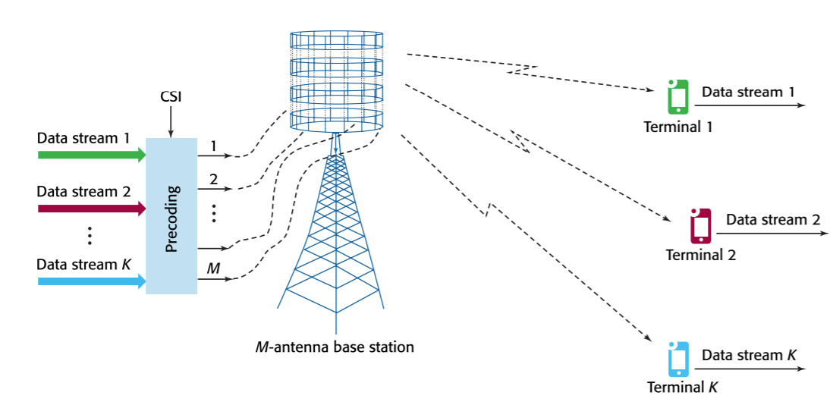
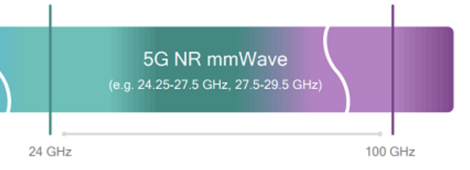
Traditional Solutions
Massive MIMO
Millimeter Wave Communication
High speed
Large band width
Spatial–division multiplexing
Phased array antenna
High cost and power consumption; Difficult to deploy
[8] T. L. Marzetta, et al.

Slide 6
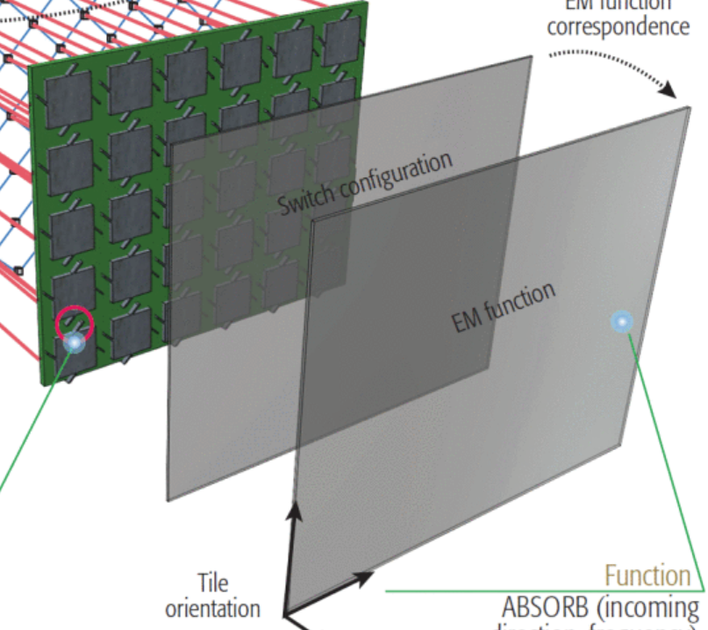
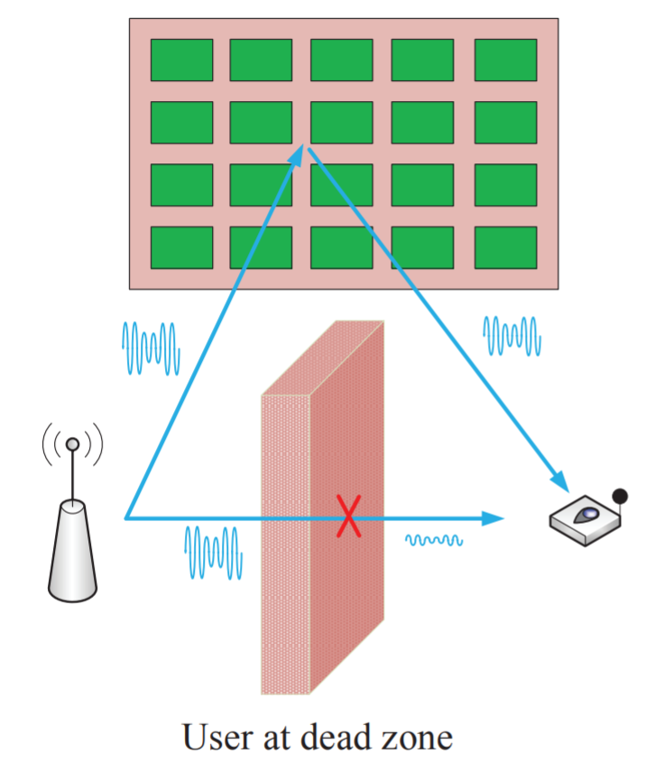
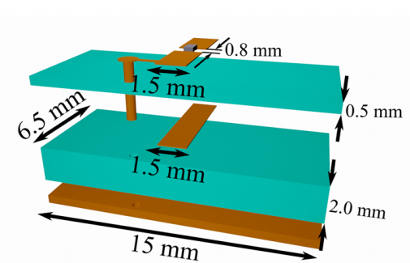
Intelligent Metasurface
Sample Structure
Dead Zone Relay
Programmable
Low cost; Low power consumption
High reliability
Intelligent programmable
High-precision
[9] Q. Wu and R. Zhang. [10] C. Liaskos, S. Nie, et al. [11] Popov, Vladislav, et al.

Slide 7
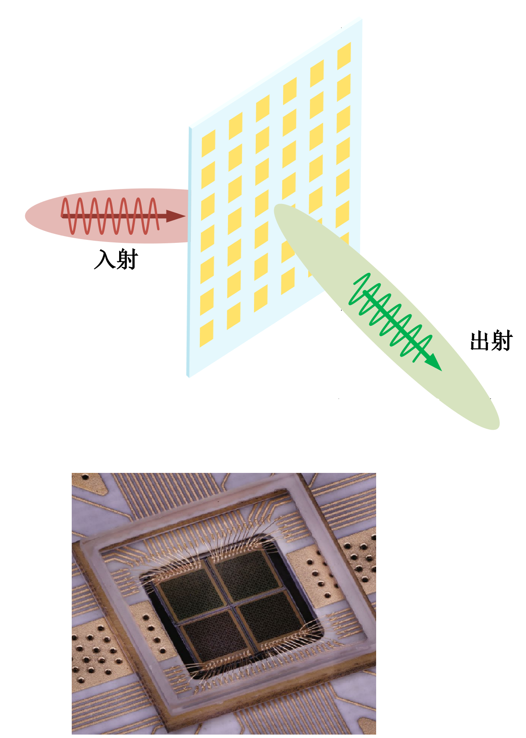
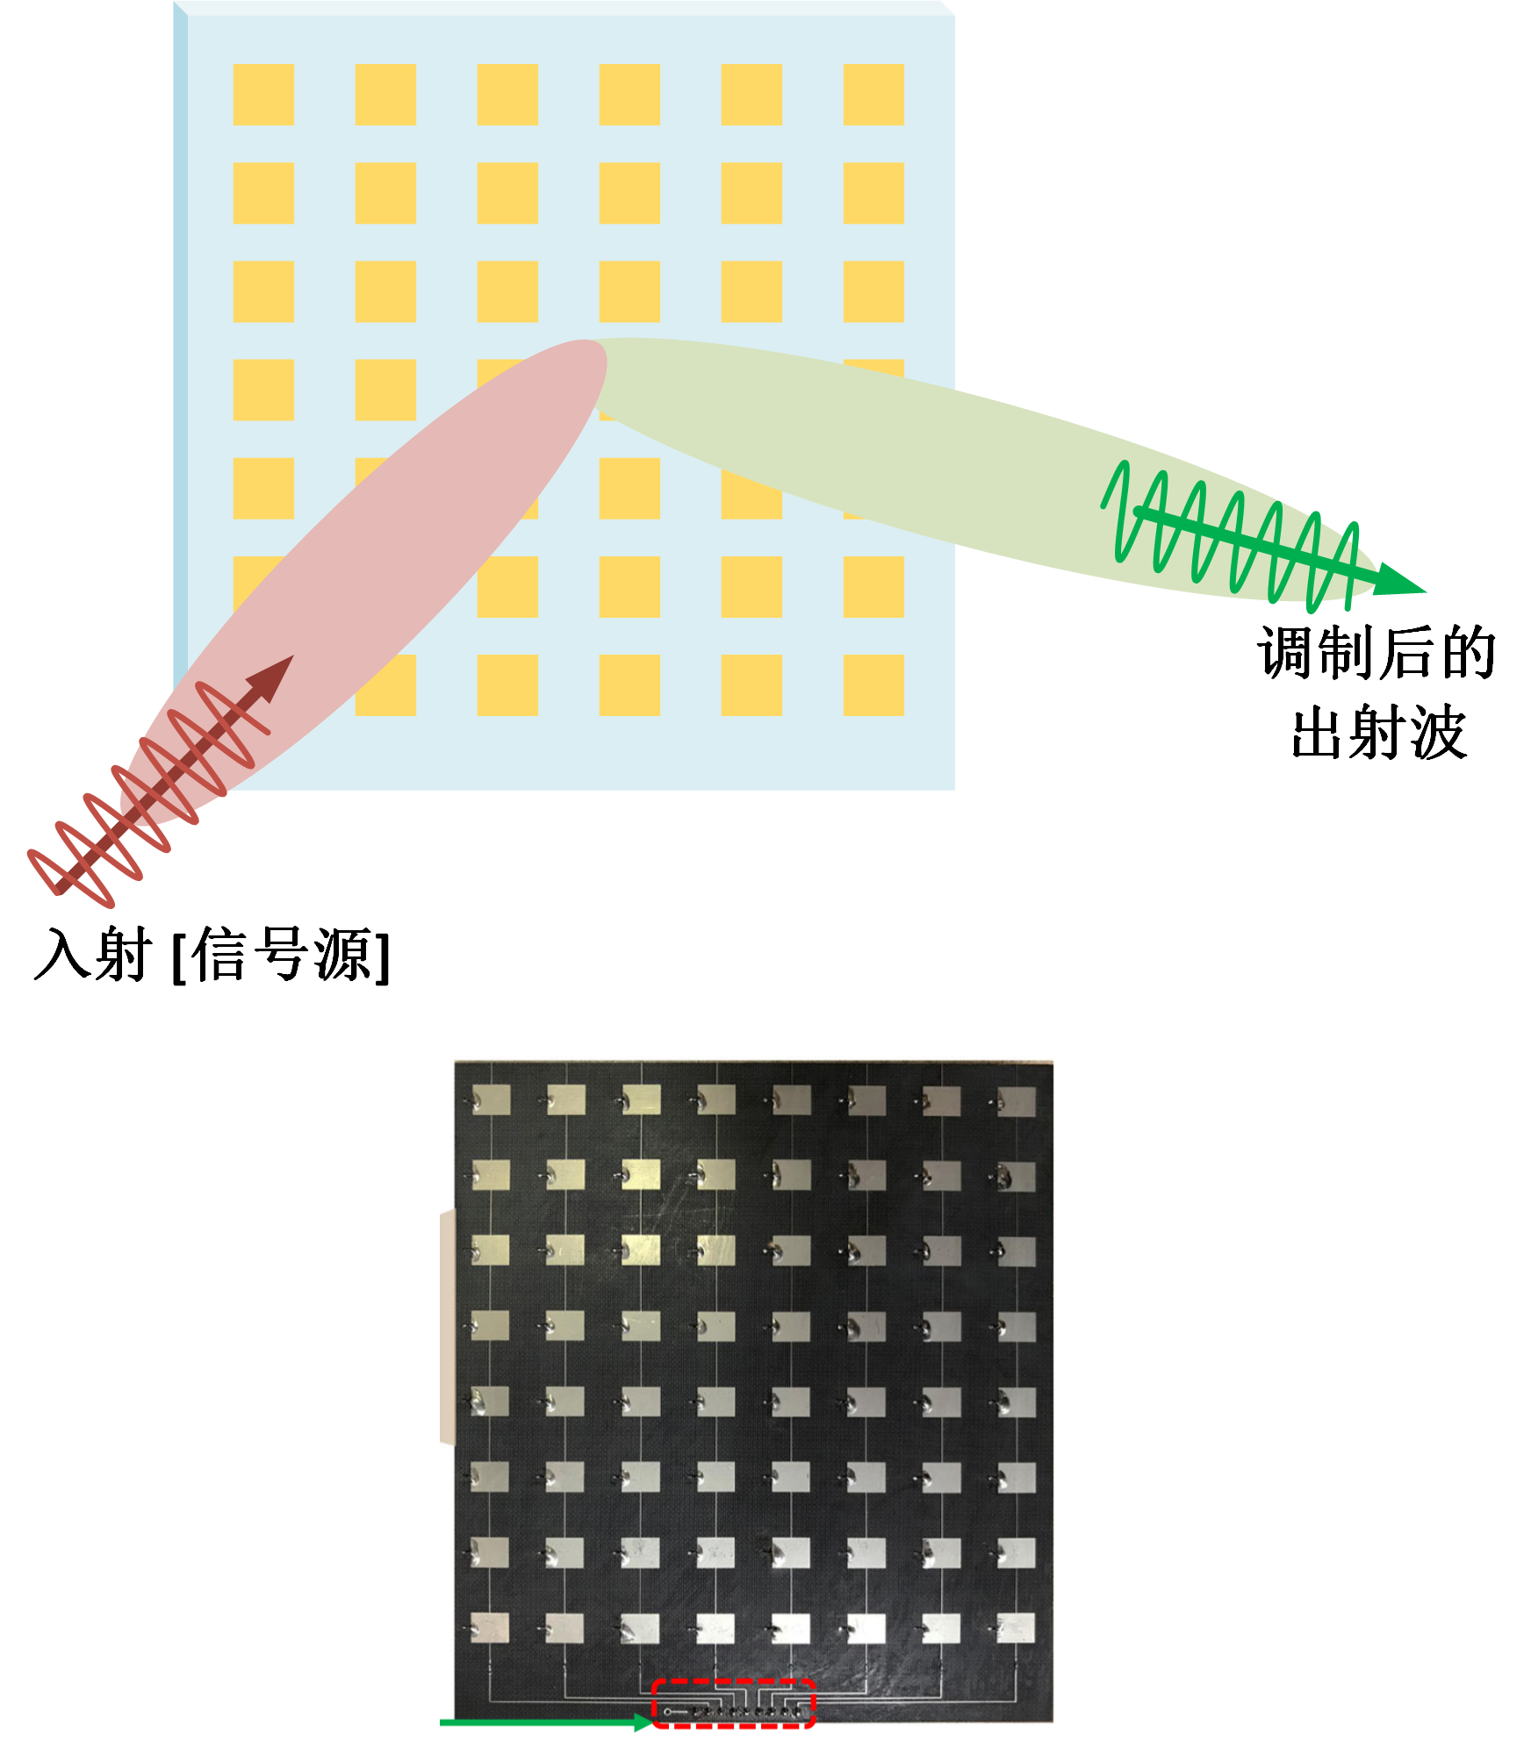
Classification
Transmission
Reflection
Similar principle and effect
Reflection: Easier to design & Less control circuit requirements
Transmission: Transmitter & Circuits may block transmission

Slide 8
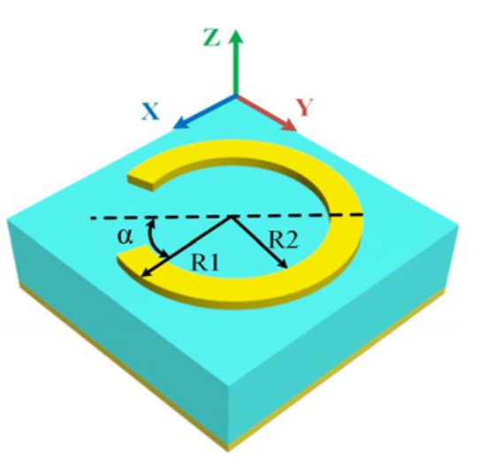
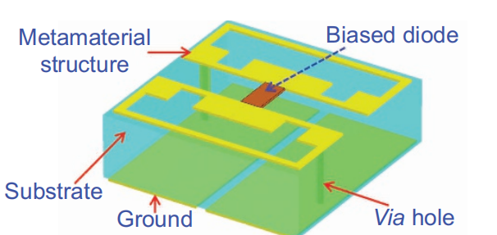
Classification
Passive
Active
Passive: Stable, Easy to design, Fixed scattering pattern
Active: Flexible, Hard to design, Arbitrary control of EM wave
[1] Bao, Lei, et al. [2] Cui TJ, et al.

Slide 9
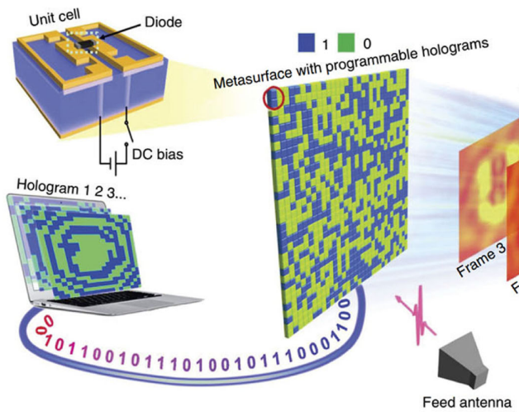
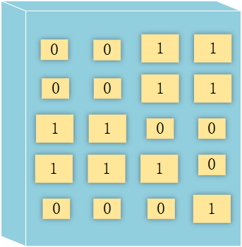
Programmable
Programmable
Coding
Phase, Amplitude, Polarization Modulation
Trade off: Phase granularity, radiation efficiency → Multilayer
Hard to achieve continuously tunable phase
[3] A. H. Abdelrahman, A. Z. Elsherbeni and F. Yang. [12] Li L, et al.

Slide 10
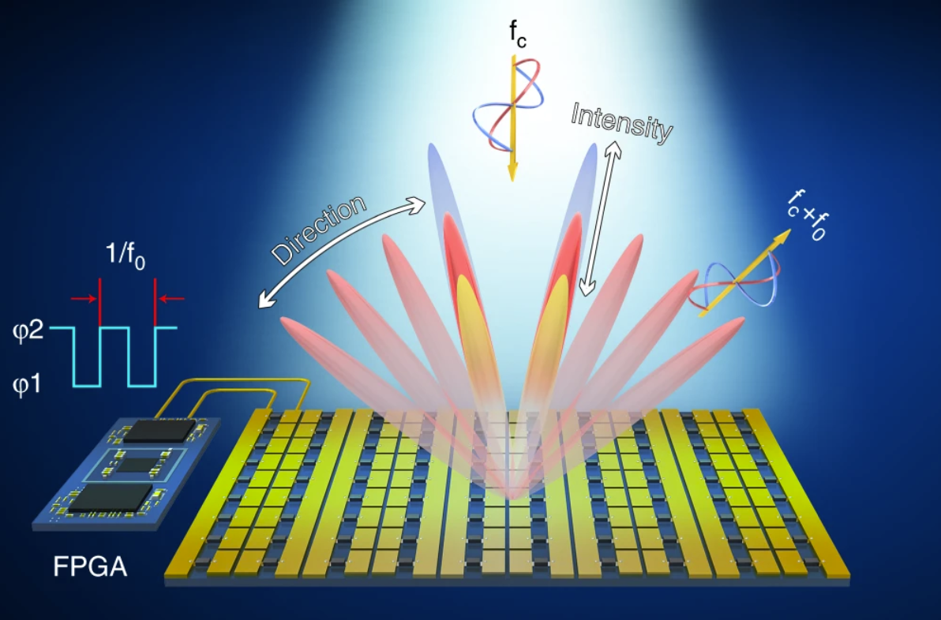
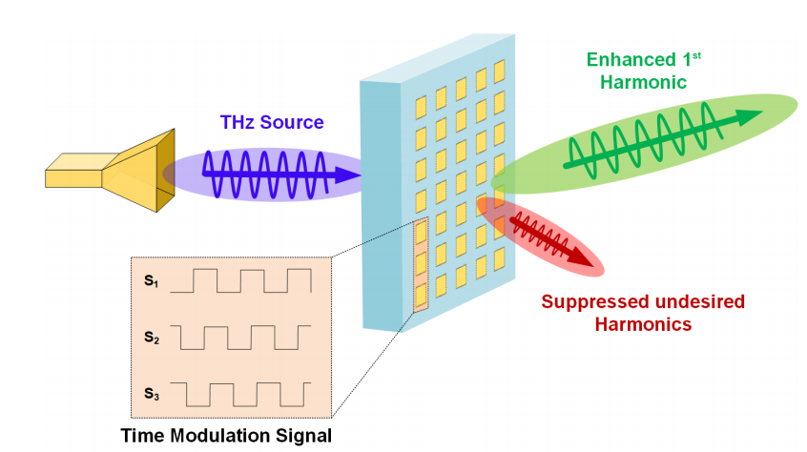
4-th Dimension
Continuous coding
Phase & Amplitude control
Flexible Space Modulation
Harmonic Suppression
Reduce loss
[4] Dai JY, et al.

Slide 11
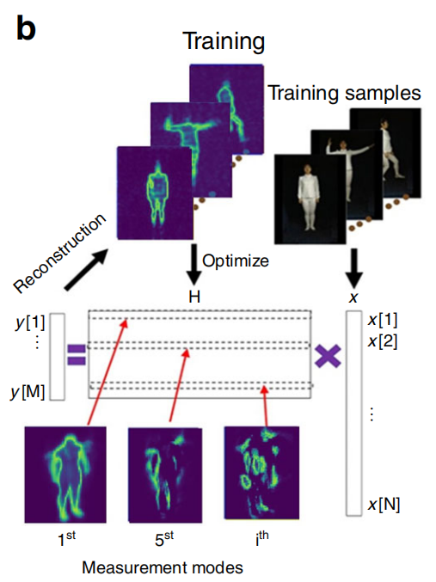
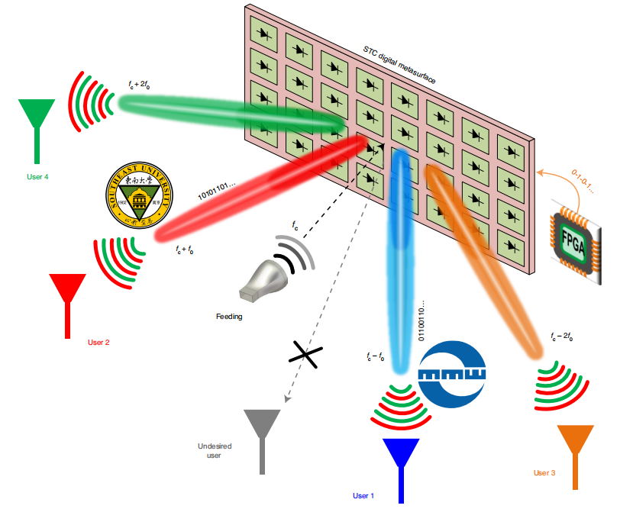
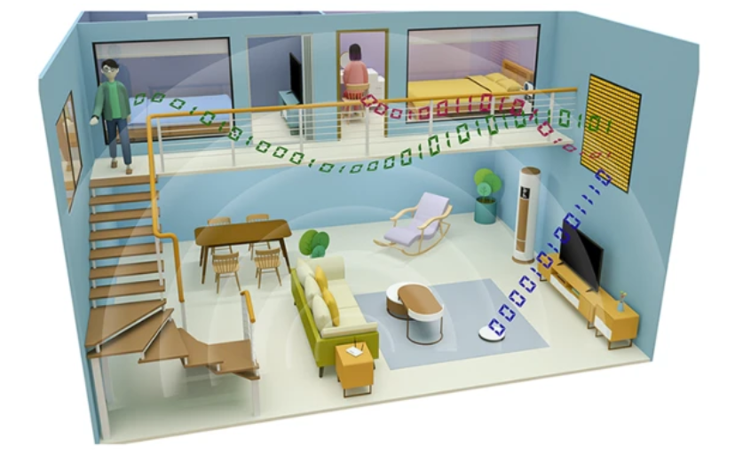
More Applications
Metasurface Imaging
Encrypted MIMO Communication
Multi-user
Machine Learning based Imaging System
Utilization of Harmonics
Special Coding Pattern
[5] Li L, et al. [6] Zhang, Lei, et al. [7] Zhao Hanting, et al.

Slide 12
Outline
Introduction
Traditional Solutions
Metasurface
Harmonic Suppression Theory
Unit Cell Design
Simulation Results
Conclusion

Slide 13
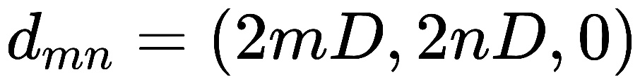
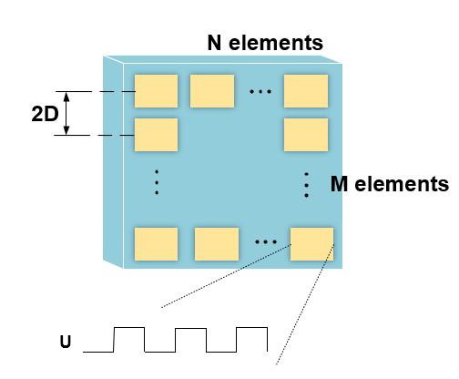
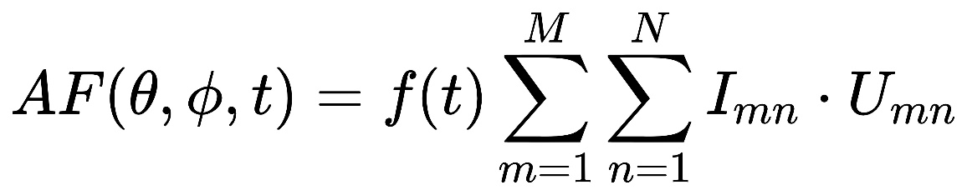
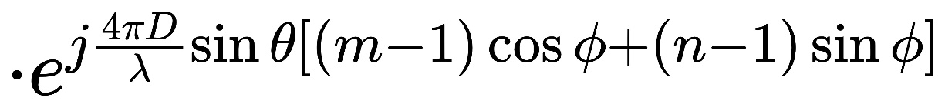
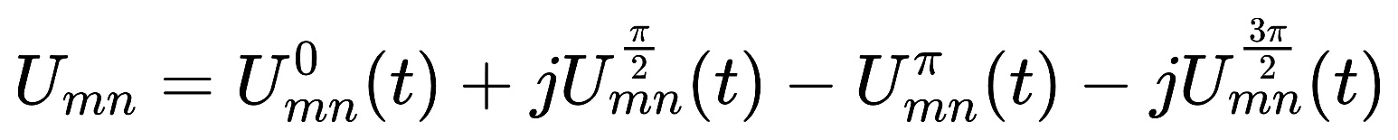
Harmonic Suppression Theory
Phased Array
Notes:
Suppose that the origin is defined at the center of the bottom left unit cell and the whole metasurface has M rows and N columns in total, then the coordinate of the unit structure on the mth row and nth column under the ideal case can be defined as (click)
Therefore, the array factor can be expressed as ( click ) where θ and ϕ define the elevation angle and azimuth angle, f(t) denotes the incident wave, Imn is transmittance of meta element and Umn is the time modulation sequence which can be expressed as (click)
Those four items denotes the control sequences for the four meta-elements.

Slide 14
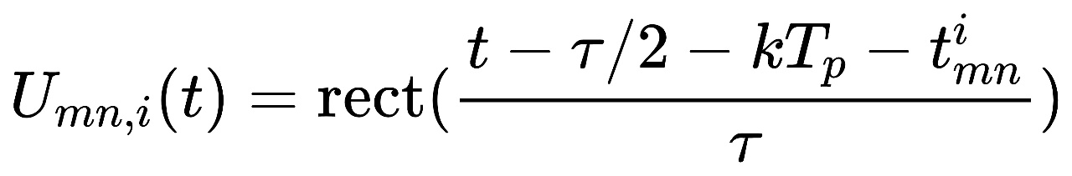
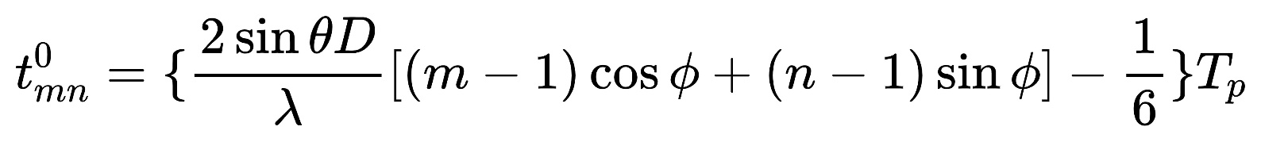
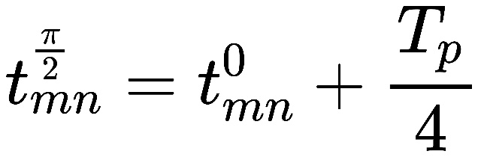
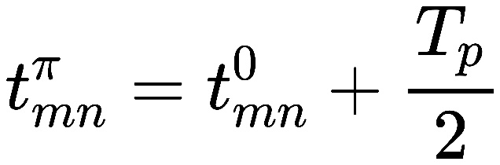
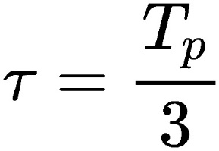
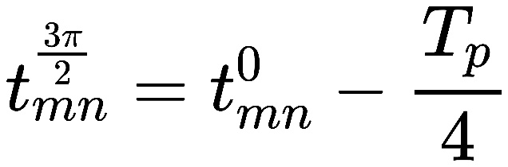
Harmonic Suppression Theory
Phased Array
Notes:
And control sequence of each item can be expressed as a rectangular wave. (click)
where Tp is the period of the modulation sequence, τ is the time length of the "ON" state and t i mn is the switch-on time. The switch-on time of the four meta-elements and the time length of the "ON" states are optimized as (click) these four functions to eliminate undesired harmonics. The optimization is provided by analysis of Fourier series of the control sequences.

Slide 15
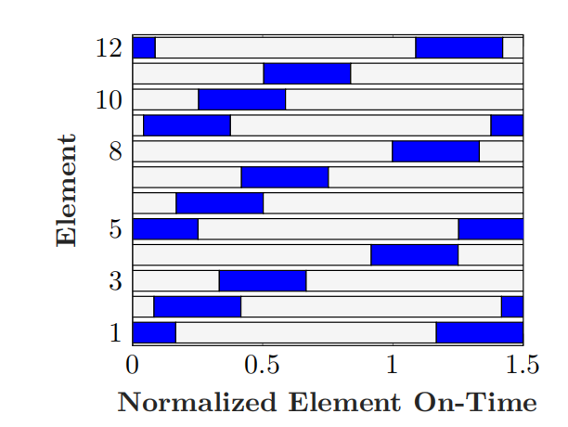
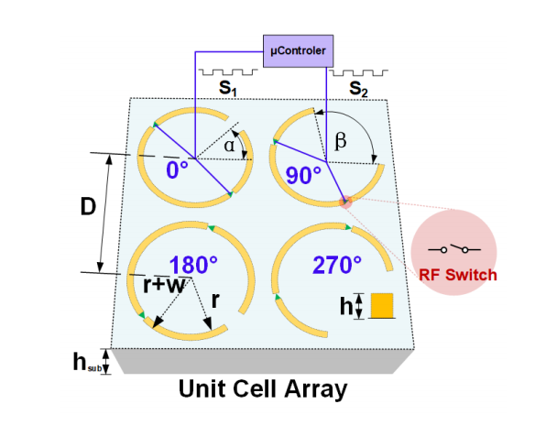
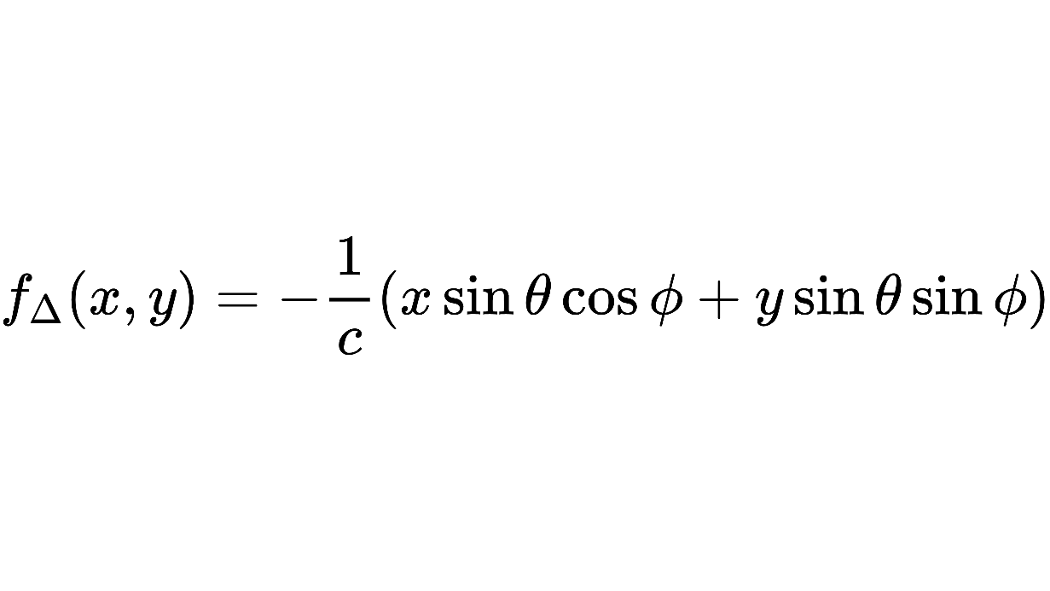
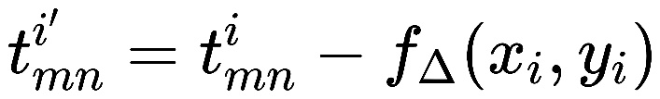
Harmonic Suppression Theory
STPM

Slide 16
Outline
Introduction
Traditional Solutions
Metasurface
Harmonic Suppression Theory
Unit Cell Design
Simulation Results
Conclusion

Slide 17
Unit Cell Design
Four 1-bit elements with 5 states
Off state: Low transmittance
On states: Phase modulations
8 pin diodes controlled by FPGA
Notes:
The metasurface is designed to be fabricated on a Rogers printed circuit board with a top copper thickness h, a subtrate thickness hsub, and a dielectric constant of 3.66. The split-ring-resonator (SRR) inspired meta-elements are designed to operate at a center frequency of 4.3 GHz with a inner diameter r and a thickness w.
Two PIN diodes controlled by a micro-controller are added to each SRR to realize fast and independent element modulation. Through the design of opening angle β and orientation angle α, different phase modulation values can be realized. Four "ON" states with different phase shifts can be achieved by turning on the corresponding meta-element while turning off the reminders, and the "OFF" state can be produced by turning off all PIN diodes.

Slide 18
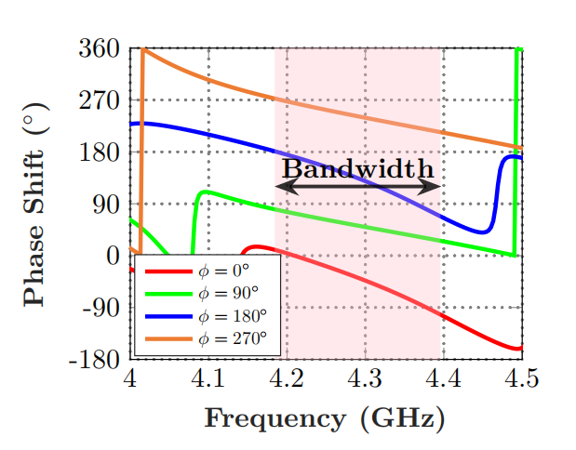
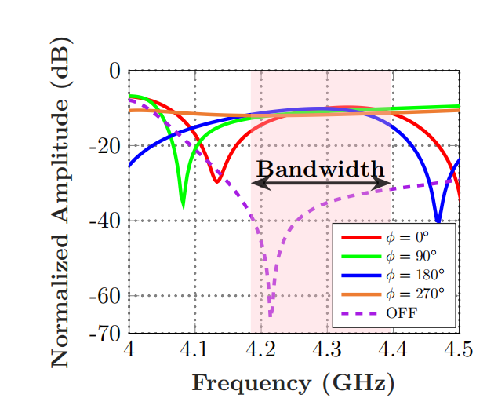
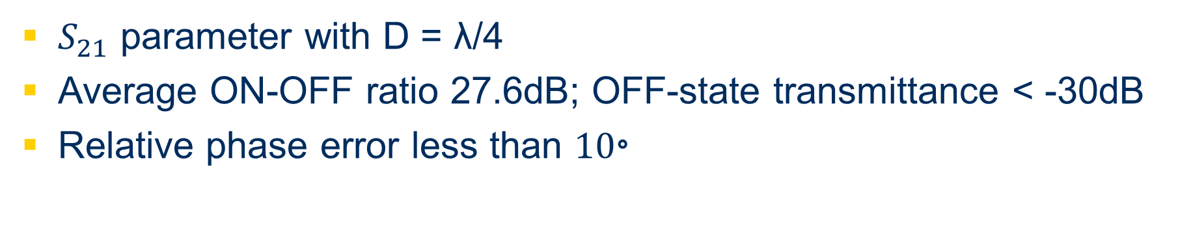
Unit Cell Design
Phase
Amplitude
$S_{21}$ parameter with D = λ/4
Average ON-OFF ratio 27.6dB; OFF-state transmittance < -30dB
Relative phase error less than ${10}^{。}$
Notes:
Those two figures show the phase and amplitude pattern of the unit cell.
Bandwidth is defined as the frequency range in which the "ON"-"OFF" ratio is greater than 20 dB, the transmittance is greater than negative12 dB and the relative phase error is less than 10◦ . At the center frequency, 4.3 GHz, the simulation results show that within the bandwidth, the average "ON"-"OFF" ratio is 27.6 dB and the OFF-state transmittance is less than minus 30 dB.

Slide 19
Outline
Introduction
Traditional Solutions
Metasurface
Harmonic Suppression Theory
Unit Cell Design
Simulation Results
Conclusion
Notes:
Then we can come to simulation results

Slide 20
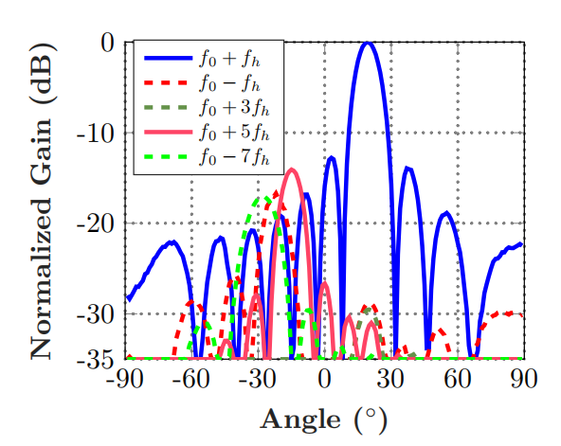
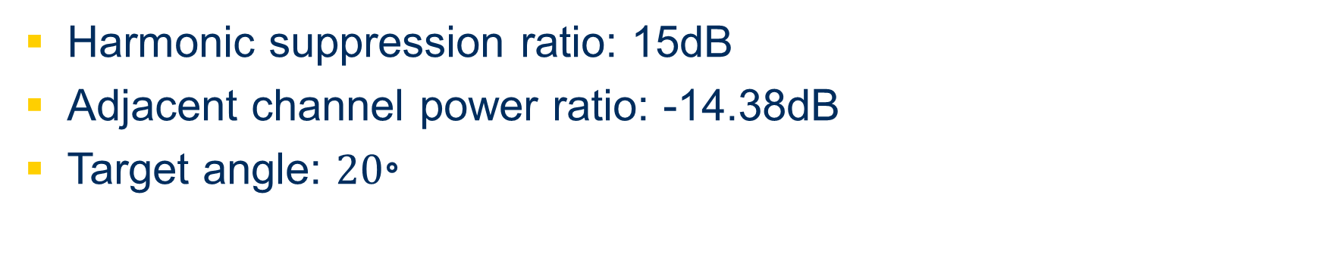
Simulation Result
Harmonic suppression ratio: 15dB
Adjacent channel power ratio: -14.38dB
Target angle: ${20}^{。}$
Notes:
Simulation is performed to validate the STPM method with D = λ/4, a targeted angle 20◦ and center frequency 4.3 GHz.
The figure on the left is a subset of modulation sequences of twelve metasurface unit cells
The figure on the right shows the normalized power on five harmonics containing the most power. The normalized power of the harmonics are all less than -15 dB and the adjacent channel power ratio reaches -14.38 dB which is calculated by the sum of the power of fifth harmonic over the sum of the power of the main wave.

Slide 21
Outline
Introduction
Traditional Solutions
Metasurface
Harmonic Suppression Theory
Unit Cell Design
Simulation Results
Conclusion
Notes:
Finally, let’s summarize our work

Slide 22
Conclusion
A time modulated programmable metasurface architecture and its modulation sequences are designed to ensure both flexibility and efficiency of beamforming and undesired harmonics suppression.
The metasurface unit cell contains four ”ON” states and one ”OFF” state with low transmittance. Within the bandwidth, the system shows a high ON-OFF ratio and high harmonic suppression ratio.
All these results prove the ability of the STPM to achieve high efficient beamforming and undesired harmonic suppression, indicating the potential for applying in practical communication applications.
Notes:
Read……

Slide 23
References
[1] Bao, Lei, et al. "Multi-beam forming and controls by metasurface with phase and amplitude modulations." IEEE Transactions on Antennas and Propagation 67.10 (2019): 6680-6685.
[2] Cui TJ, et al. Coding metamaterials, digital metamaterials and programmable metamaterials. Light Sci Appl. 2014;3:e218.
[3] A. H. Abdelrahman, A. Z. Elsherbeni and F. Yang, "Transmission Phase Limit of Multilayer Frequency-Selective Surfaces for Transmitarray Designs," in IEEE Transactions on Antennas and Propagation, vol. 62, no. 2, pp. 690-697, Feb. 2014, doi: 10.1109/TAP.2013.2289313.
[4] Dai JY, et al. Independent control of harmonic amplitudes and phases via a time-domain digital coding metasurface. Light Sci Appl. 2018;7:90.
[5] Li L, et al. Machine-learning reprogrammable metasurface imager. Nat Commun. 2019;10:1082.
[6] Zhang, Lei, et al. "A wireless communication scheme based on space-and frequency-division multiplexing using digital metasurfaces." Nature Electronics 4.3 (2021): 218-227.
[7] Zhao, Hanting, et al. "Metasurface-assisted massive backscatter wireless communication with commodity Wi-Fi signals." Nature communications 11.1 (2020): 1-10.
[8] T. L. Marzetta, "Massive MIMO: An Introduction," in Bell Labs Technical Journal, vol. 20, pp. 11-22, 2015, doi: 10.15325/BLTJ.2015.2407793.
[9] Q. Wu and R. Zhang, "Towards Smart and Reconfigurable Environment: Intelligent Reflecting Surface Aided Wireless Network," in IEEE Communications Magazine, vol. 58, no. 1, pp. 106-112, January 2020,
[10] C. Liaskos, S. Nie, A. Tsioliaridou, A. Pitsillides, S. Ioannidis and I. Akyildiz, "A New Wireless Communication Paradigm through Software-Controlled Metasurfaces," in IEEE Communications Magazine, vol. 56, no. 9, pp.
[11] Popov, Vladislav, et al. "Reconfigurable Sparse Metasurface: Beamforming Beyond Phase Gradient Heuristics." 14th European Conference on Antennas and Propagation (EUCAP 2020). 2020.
[12] Li L, et al. Electromagnetic reprogrammable coding-metasurface holograms. Nat Commun. 2017;8:197.
Notes:
Here are some references

Slide 24

Thank You!
Notes:
Thank you for your listening!

